Slide 1
Predictive Modelling Competition
Group: Joseph Kernisan, Kevin Nguyen, Sophia Dekimeche, Tereza Rosier

Slide 2
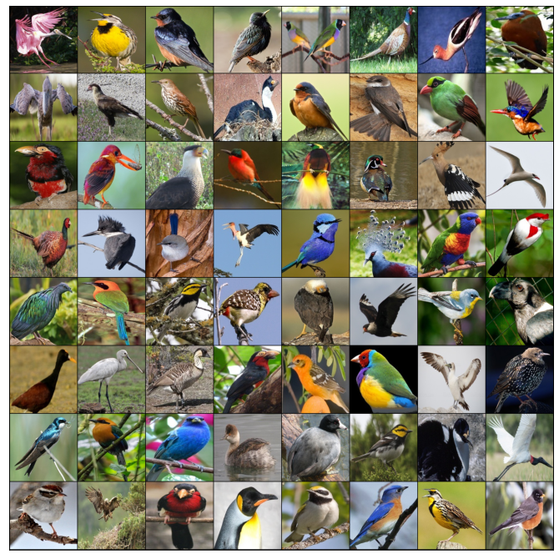
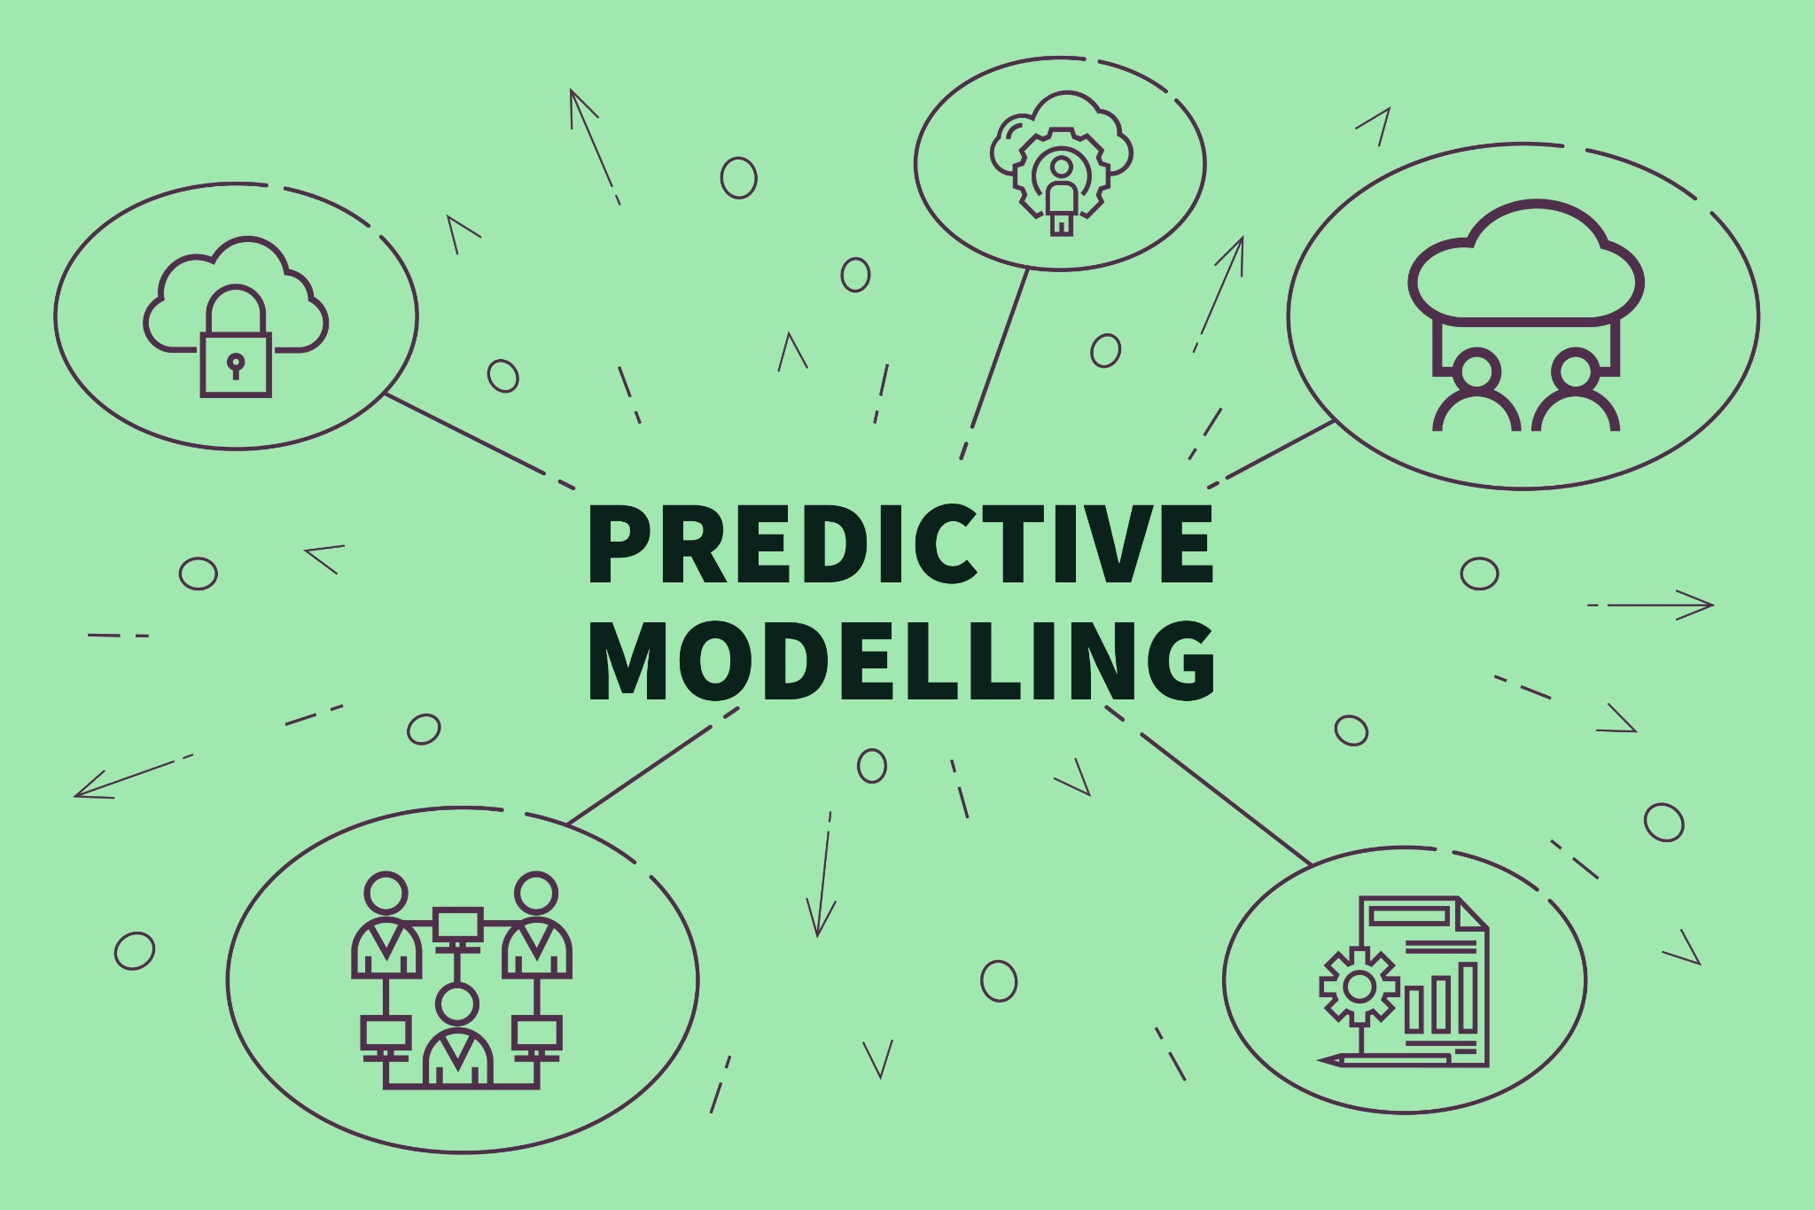
Introduction and Project Overview
Predictive Modeling Competition: Bird Species Classification
Dataset Overview: Demonstrate skills in image classification the Bird Species dataset from Kaggle
Project Goals:
Develop a CNN to classify 15 different bird species.
Focus on effective data handling, preprocessing, and model accuracy.

Slide 3
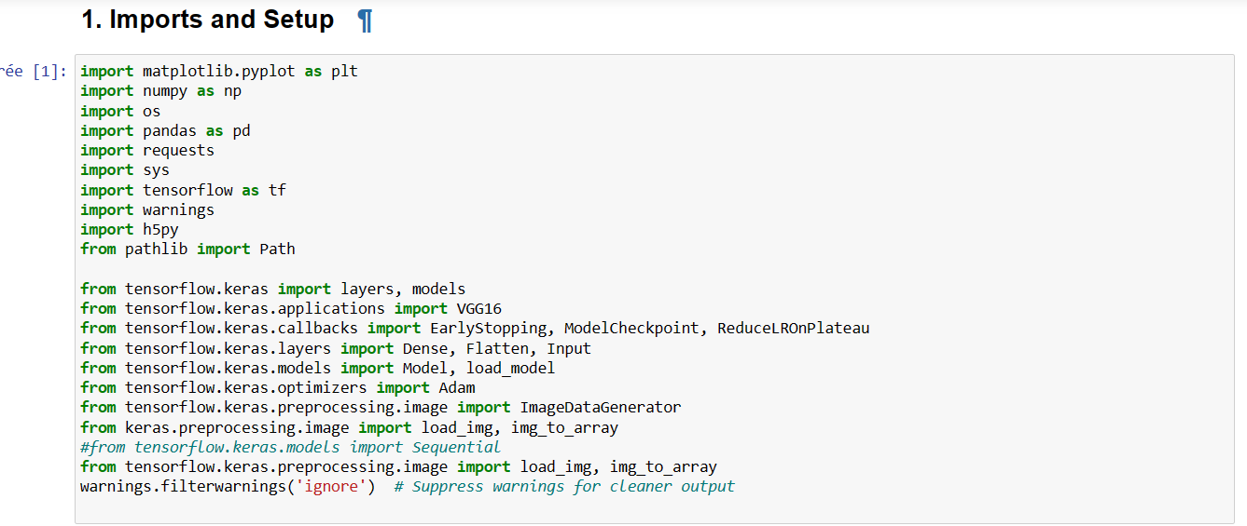
Challenges and Technical Setup
Constraints:
Reduced the number of classes from a higher count to 15 to manage complexity.
Model designed to make predictions on specifically indexed classes.
Technical Approach:
Utilized TensorFlow for deep learning model construction.
Pandas, NumPy, and Matplotlib for data handling and visualization.

Slide 4
Data Strategy and Model Architecture
Data Setup:
Organized directories for training, validation, and test datasets.
Ensured all sets contain the same bird species for consistency.
Model Preparation:
Imported essential libraries and set up data paths.
Verified data integrity and consistency using Pandas.

Slide 5

Automating Image and class Indexing for Machine Learning Projects
The Purpose of Indexing
The ‘’index_images_with_classes’’ Function
Collecting Indexed Data
Executing the Script
Practical Example
Conclusion and Next Steps
The ‘’get_class_names_from_directory’’ Function
Using the Function
Output of the Function
Conclusion and Next Steps

Slide 6
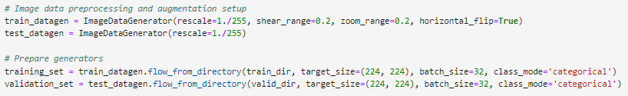
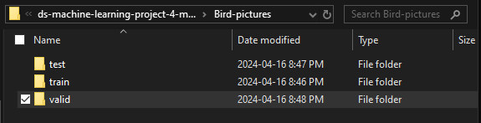
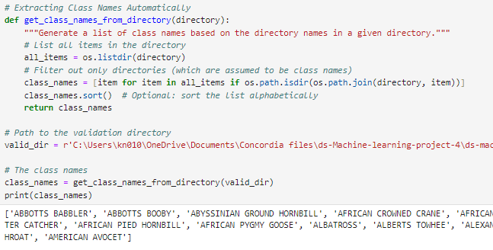
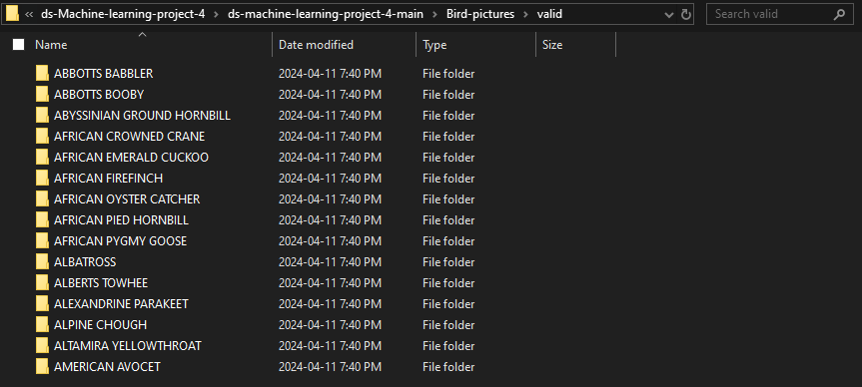
Simplifying Class Name Retrieval & Image Preprocessing

Slide 7
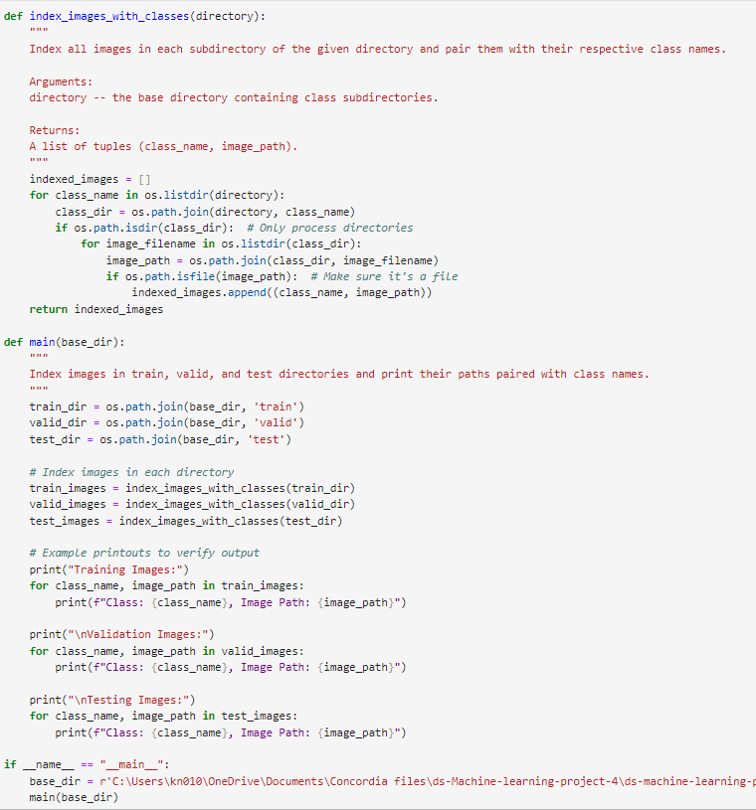
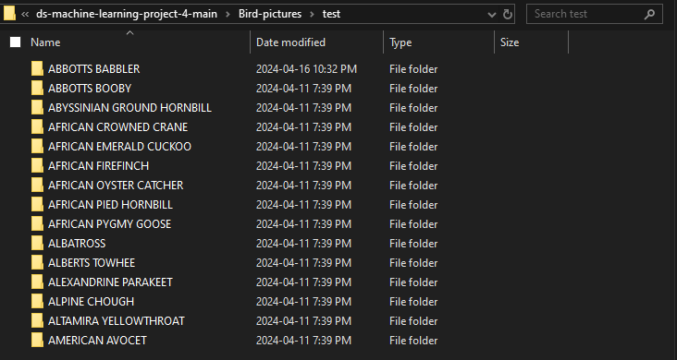
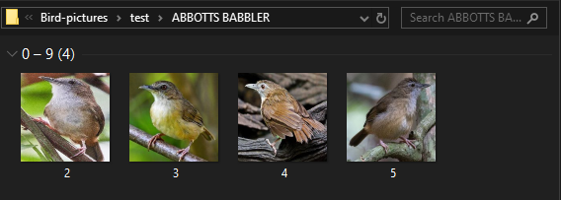
Image indexing within each classes Function

Slide 8
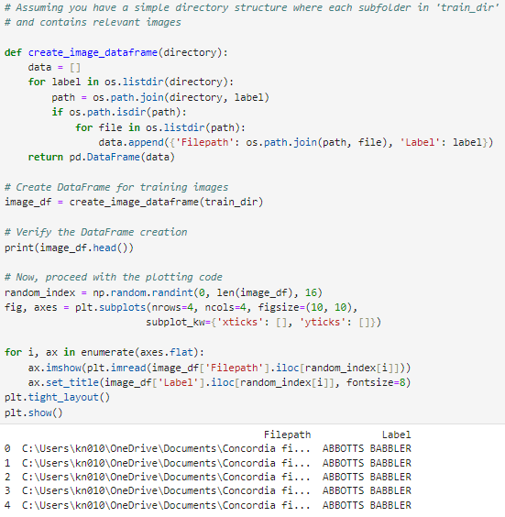
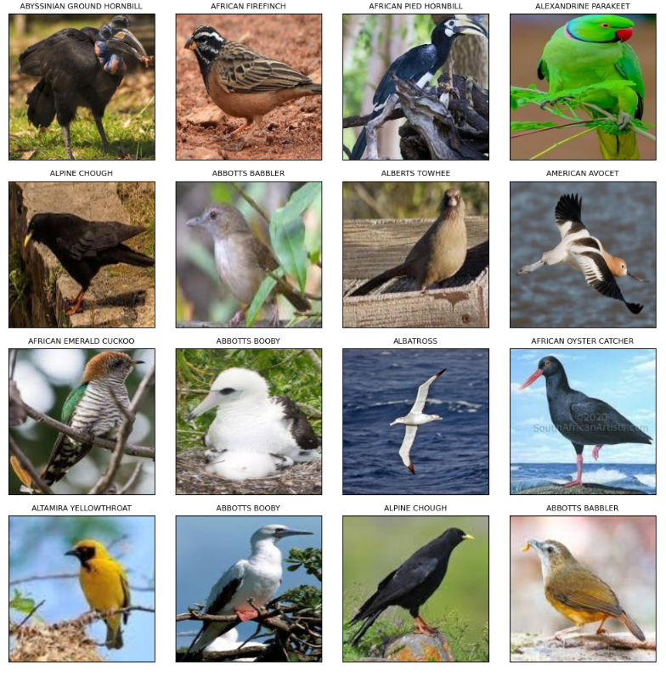
Image Sample of all classes

Slide 9
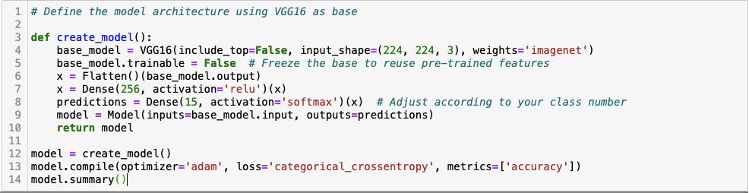
Model Architecture and Training Process
Welcome to our detailed overview of the neural network model used in our bird species classification project. Today, I'll walk you through our approach, focusing on how we leveraged a pre-trained VGG16 model and customized it to suit our needs.
We started with the VGG16 model, a robust architecture known for its performance in image classification tasks. This model comes pre-trained on ImageNet, which contains millions of images across thousands of categories.
Code Explanation: "Here’s how we set it up: VGG16(include_top=False, input_shape=(224, 224, 3), weights='imagenet'). We disable the top layer to customize the output layers for our specific class count, which is 15 in this case."
We then freeze the base layers of the model to retain the pre-trained features, ensuring that only the new layers we add will be trained.

Slide 10
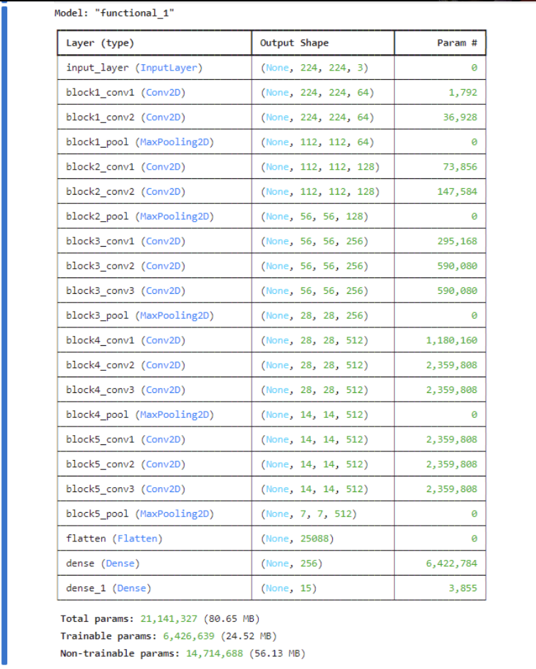
Model Architecture and Training Process (continued)
After setting up the base, we add our custom layers to fine-tune the model to our dataset."
Code Explanation: "We use Flatten() to convert the 3D feature maps to 1D, followed by a dense layer with 256 neurons activated by ReLU to introduce non-linearity and capability to learn complex patterns. Finally, a softmax layer outputs probabilities across 15 classes."
This configuration allows our model to specifically learn from the bird image dataset, tailoring the powerful VGG16 features to better recognize different bird species."

Slide 11
Model Compilation
Once our model architecture is in place, we compile it to define the loss function and optimizer.
Code Explanation: "model.compile(optimizer='adam', loss='categorical_crossentropy', metrics=['accuracy']). We use Adam as our optimizer because of its efficiency in handling sparse gradients and adapting learning rates. Categorical crossentropy is chosen as the loss function since we are dealing with multi-class classification.
Implementing Callbacks
To enhance training effectiveness and prevent overfitting, we implement several callbacks.
Code Explanation:
EarlyStopping: "Monitors validation loss and stops training if no improvement is seen for three epochs, helping prevent overfitting."
ModelCheckpoint: "Saves the model at the state where it achieved the lowest validation loss, ensuring we always have the best performing model saved."
ReduceLROnPlateau: "Reduces the learning rate when the validation loss plateaus, optimizing further learning steps."
These callbacks are crucial for maintaining efficient training cycles and ensuring high model performance without wasting computational resources.

Slide 12
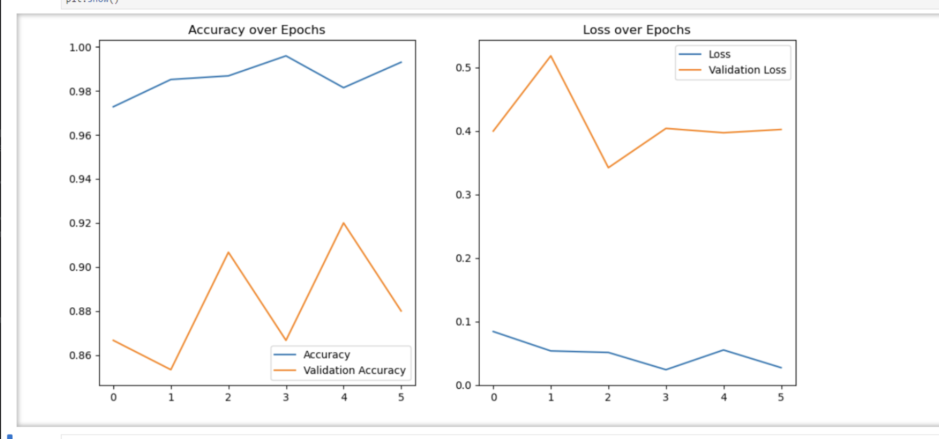
Training and Validation Results
Let’s look at the training process. We trained our model for up to 10 epochs, but due to our callbacks, training stopped after 6 epochs when the validation loss did not improve further.
Code Explanation: "The model shows an impressive training accuracy and a solid validation performance, indicating our model is well-tuned and not overfitting."
The model's training process, scheduled for 10 epochs, ceased after 6 due to the EarlyStopping callback, which halts training if the validation loss fails to improve for a given number of epochs. Despite some fluctuations, the high training accuracy and the close tracking of validation accuracy suggest good generalization without overfitting.
The slight fluctuations in validation loss suggest that while the model is generally robust, further fine-tuning or additional data might help stabilize and improve its performance.
Conclusion
In conclusion, our adapted VGG16 model demonstrates excellent potential for accurately classifying bird species from images. The combination of a strong architectural foundation and smart training strategies like callbacks has positioned us well to tackle this challenging task.

Slide 13
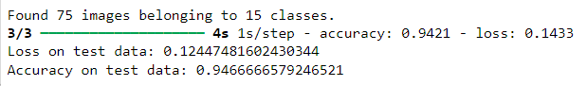
Model Saving & Prediction
“model.save('New_model.h5')”
HDF5 format (Python’s library: h5py)
Warning was ignored
“New_model.h5” loaded with “tf.keras.models.load_model”
Test generator created with “flow_from_directory”
test data
target_size: 224, 224 (for VGG16 model)
batch_size= 32
class_mode= categorical
Evaluation performed with “.evaluate”

Slide 14
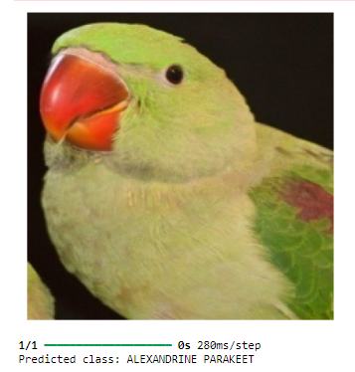
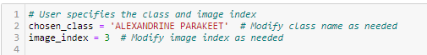
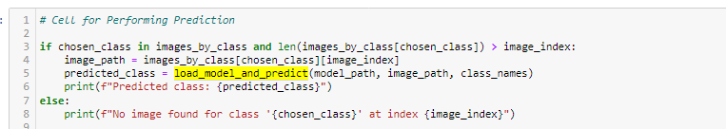
Functions:
“index_images_by_class”:
argument: directory
called for “valid_dir”
indexes images by class
stores in {}
“load_model_and_predict”:
3 args (load trained model, image path, class names)
called for the “chosen_class”
prediction: highest probability (argmax)

